Slide 1
Evaluation Webinar
WEBINAR WILL BEGIN AT 14:00
Tanya Fosdick (Head of Research)
Amanpreet Kaur (Research and Evaluation Analyst)
Notes:
TF – Introductions

Slide 2
Webinar Support
Please use the Q&A Section to ask questions – We will answer as many as we can
This is being recorded and will be available to review shortly
The PDF slides are also available
Notes:
Questions at the end – use the Q and A facility, not the chat or hands up.

Slide 3
Today’s session
Why evaluate?
Types of evaluation
Evaluation designs
Methodologies
Approaches
Questions
Notes:
TF
Obviously a lot we could discuss in a webinar about evaluation and unfortunately, we only have an hour so we will touch about these topics.
We will talk about why we should evaluation, the types of evaluation we might want to consider undertaking, start to think about evaluation designs and methodologies and how these approaches can be used in reality and then we will move onto your questions.

Slide 4
Why Evaluate?
Notes:
AK
So, why evaluate?
An evaluation helps you to identify and demonstrate whether your intervention has or hasn't had an intended effect. For example, has it changed people’s intentions to use a mobile phone while driving?
Evaluations can also help you provide evidence to funders and policymakers about the effects of your intervention
Evaluation can tell you how your interventions can be improved to better meet your objectives, it can tell you which version of a message will be more effective in changing behaviour, it can also tell you if there are any additional benefits to your intervention
By evaluating interventions we can learn from one another and share what works and what doesn't work – not repeating mistakes
A lot of money goes into designing a product or implementing interventions – therefore it is necessary to see if it works and to see if it was value for money
Evaluation ensures that your intervention doesn’t do any harm or have unexpected negative consequences

Slide 5
Process vs outcome
To improve the intervention delivery (process)
To show the effectiveness of the intervention (outcome)
Notes:
AK
Two types of intervention – process and outcome – can be both
A process evaluation is to improve the intervention delivery and an outcome evaluation is to show the effectiveness of the intervention
So, an evaluation is not if they enjoyed the session or how many people attended it is about the delivery and/or the effectiveness of the intervention

Slide 6
Process
Process: important for understanding if delivery could be improved.
  Are they the right participants, accessing the intervention in the right way?
  Is advertising working?
  Does it work to time?
  Are there technical issues?
  Could numbers of participants be increased?
  Are those delivering it confident with the content?
Recent review of road safety behaviour change work in UK – an average of 45% of interventions are evaluated, with 78% done internally – mostly process?
Notes:
TF

Slide 7
Outcome
Day long pre-driver intervention – presentations on learning to drive process and road safety (consequences) plus car park drive
‘Basic’ evaluation (pre and post questionnaires):
  Some positive results
‘In-depth’ evaluation (pre and post questionnaires plus focus groups):
  Pre group work – positive attitudes towards road safety
  After focus groups – “excusing” risky behaviour
  Post questionnaires – increases in perceived proportions of drivers engaged in risky behaviours
Despite best intentions, normalised bad behaviour through the intervention
Intervention revised and re-evaluated (better results!)
Notes:
TF
Outcome evaluations are where we assess the effectiveness of an intervention.
Importance of using correct methodology and not taking results at face value – could still be doing harm
Example here

Slide 8
Evaluation Designs
Randomised Controlled Trial (RCT)
Comparison Design
Before and After
Notes:
AK
These are the main evaluation designs used for road safety interventions
Randomised controlled trial – involves randomly allocating people to receiving the intervention or not receiving it = Intervention group and the control group.
Comparison design – one group has the intervention and one group doesn’t = compare (before and after) = not randomly allocated so means that it is possible that the two groups differ in some way
Before and after – for example pre survey week before and then a post survey a week after – possibility that something else (external) has influenced their attitude (not intervention) wont know because there is no comparison group

Slide 9
Methodology
Quantitative
Qualitative
Mixed Methods
Notes:
AK
Once you've decided on a evaluation design – need to think about what methods you will use to collect the data.
Quantitative, qualitative or mixed methods?

Slide 10

Quantitative Research Methods
Surveys - whether conducted online, by phone or in person. These rely on the same questions being asked in the same way to a large number of people
Notes:
AK
Usually tend to be surveys – they rely on the same questions being asked in the same way to a large number of people
So they're great for collecting data on a large scale
Enables you to look at overall averages and percentages
Measuring how much change there has been from the Pre and Post stages and if there are any significant differences
It can help you to analyse whether there is a pattern, theme or trend of those who did or didn't attend the intervention

Slide 11

Qualitative Research Methods
Interviews or focus groups:
Valuable insights into how the target audience experienced the intervention, and more importantly, whey they did or didn’t change their behaviours afterwards.
Notes:
AK
A qualitative approach provides an insight into the views of the participants in terms of what they recall from the intervention; what they felt that they had learnt; and how it could be improved.
A focus group is more than a group of individuals responding to the same questions. Responses emerge from the group interactions, with people discussing views with each other, incorporating their personal experiences and reflecting.
Focus groups enable participants to have an in-depth conversation on a wide range of subjects relating to the topics covered in the event.
Focus groups tend to be semi-structured meaning that we have a list of topics we want to cover but it allows for them to also steer the conversation and we've found that sometimes they pick up something that we hadn't initially thought of. So, we gain really interesting insights by adding a qualitative element.

Slide 12
Mixed Methods
Notes:
AK
Combining the two
Looking at the overall averages and percentages and then delving deeper to find out the reasons why there was a positive or negative change and what key messages they recall and what their thoughts were on the intervention and how it could be improved through a focus group discussion and gaining more of an insight
Ideal world mixed methods is the best methodology

Slide 13
Using data to lead the way
Needs analysis – what is the problem?
Casualty data – understand the what, when, where and how of the crashes
Who are your target audience? How can you engage with them?
National data – is your issue ‘normal’? Can you ‘borrow/learn’ from elsewhere?
The data lead your aims and objectives….. Shape what you want to achieve….
Notes:
TF
So how do we decide on an approach for evaluating?
Needs analysis is important – about getting a true picture of what the issue is, using all the available data. It will help you understand if your intervention is justified and necessary and help shape what it will seek to achieve. It can help you set the aims and objectives and design the intervention, by understanding what the outcomes might be. It will also help with future data collection – what do you know now, what can be measured, what can be used as baseline data.
Crash circumstances – will shape your messages – what you seek to change
Who are your audience? Will dictate how you engage with them and how you evaluate that engagement. How will you be able to measure any change?
Is there anything to learn from national data? Not only in terms of understanding your casualty issue but also with regards to best practice/behavioural change research/other evaluation designs – can you ‘borrow’ methodology from elsewhere to see if you can get the same results?

Slide 14
Where to start?
Set clear aims and objectives
  Defines what you are hoping to achieve
  Focuses thinking on the purpose of the intervention
  Assists with determining what to measure, how and when
Use a logic model
  Shows the process of your intervention
    Inputs – what you need to deliver the intervention
    Outputs – what is being delivered
    Outcomes – how the outputs will lead to desired changes
    Assumptions – what has been assumed about the process
    External factors – what might affect the process
Notes:
TF

Slide 15
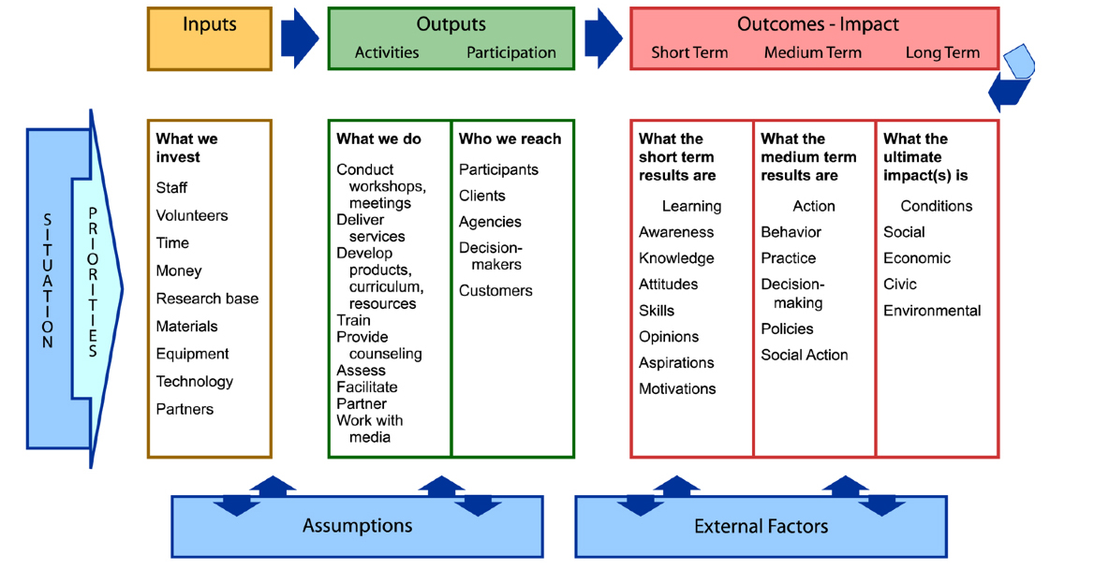
Sample logic model
Notes:
TF
Scottish Government – the idea is that it is a process – can be drawn how you like but needs to flow

Slide 16
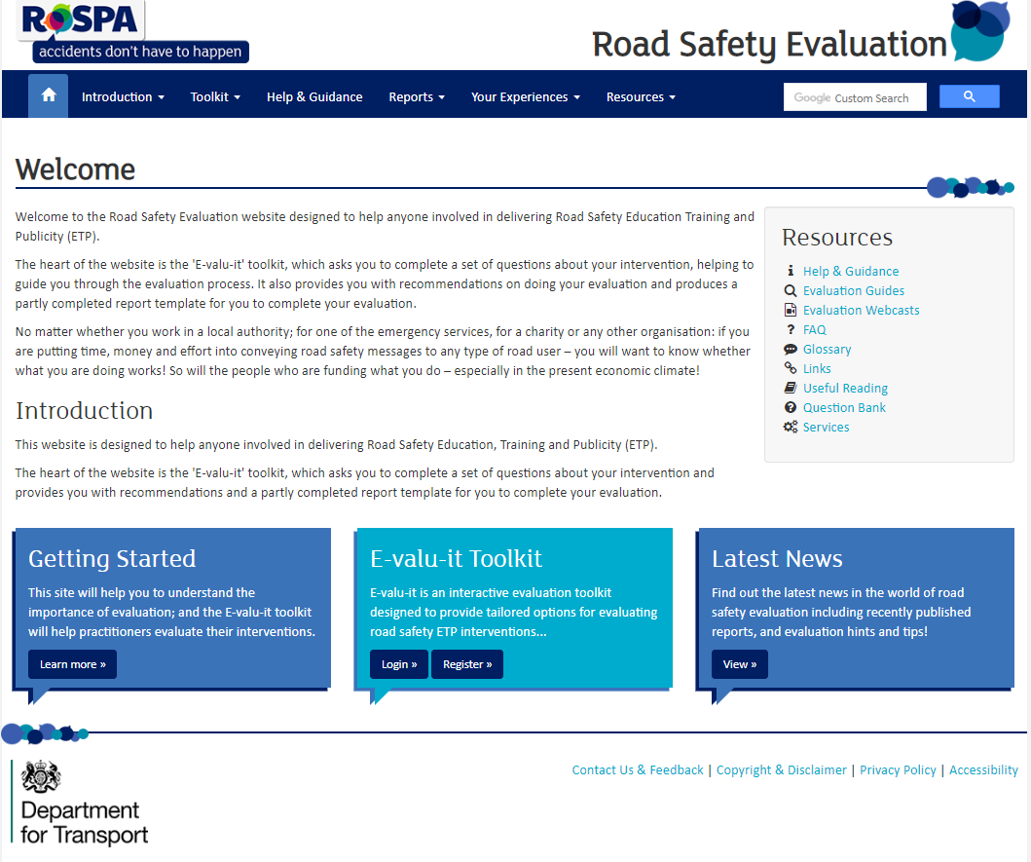
E-valu-it
roadsafetyevaluation.com
Notes:
TF
Launched 10 years ago – DfT and RoSPA. Free to use
Useful resource to plan evaluations – answering a set of questions, with reality check prompts to make you think about what data you are gathering and what you hope to achieve
The first part of E-valu-it asks you a range of questions about:
What is the local road safety issue?
Why have you chosen this issue?
What evidence do you have?
Who do you want to influence?
Who will benefit?
If you can’t answer these questions, should you really be doing it?
Some projects never get passed this point as you realise that you don’t have the evidence to justify doing it. It allows you to justify why you don’t want to do something or put a lot of resources into it.
If you are able to answer the questions and work through E-valu-it, it will provide you with some recommendations for evaluation design at the end. Those designs which are stronger (more scientific and you can have more confidence in the results) are denoted by plus signs and weaker ones by a minus sign.
There are choices of evaluation design, based on the stage of the project you are at, budget, time etc.
Also contains a useful glossary and case studies of other road safety evaluations
Template for report writing and encouraged to share

Slide 17

What is the best way to evaluate (best design and methodology)?
Most scientific approach would be to undertake a randomised controlled trial
Each evaluation is different:
Flexibility
Accessibility
Recruitment
Budget
Notes:
AK
So what is the best way to evaluate regarding the best design and methodology?
The scientific approach would be to undertake a randomised controlled trial (intervention and control group)
However, we have to bear in mind that each evaluation is different
Need to understand the circumstances, aims and objectives
How are you going to recruit your participants? so are you going to use paper or online surveys and would you benefit from doing a focus group?
Timing of evaluation must be considered and also how you're going to access your participants (so for example you won’t be able to access school children during school holidays or during exam seasons)
It is also based on the budget and how much you can do with it

Slide 18
Other considerations
Sample sizes and types
Research methods – suitability for participants (language/internet access)
Design of methods
  Questionnaire, interview and focus group design – getting accurate information back without being leading
Timing – immediate feedback or long-term?
Incentivisation
Ethical issues – working with children/vulnerable groups
Notes:
TF
Different sampling techniques, depending on whether you need a random sample or one that reflects a typical section of the population.
Sample size calculators can be used to determine if the numbers of participants are representative
Need to think about the research method used – a wordy questionnaire will not be suitable for young children or those where the language in which it is written is not their first language. Having an internet only survey could prevent the deprived or elderly from participating
There is a skill to writing questions and topic guides – ensuring it is clear what is being asked (so the respondent understand the question and is not being asked too many things at once) whilst it can’t be leading
Timing is important – it may be necessary to get immediate feedback, because access to the participants is limited or you need their response before they have had time to think about it. Or you want to measure long-term change over a year or more
Incentives might be required to encourage participation – this could be entry into a prize draw or a voucher on completion. It needs to be suitable for the audience
Obviously there are ethical issues to consider with some groups – e-valu-it gives good advice on working with children or vulnerable groups

Slide 19


Different designs
Randomised controlled trial to test effectiveness of different versions of CBT
          Pre-driver interventions – comparison groups
                Intervention only but longitudinal – over 3 years
Notes:
TF
Thinking about taking a flexible approach, these are three examples of evaluations we’ve conducted in recent years, which were designed according to the circumstances

Slide 20
What if…?
“the evaluation shows that it doesn’t work?”
“we haven’t got the budget to evaluate?”
“We don’t have the time or expertise?”
Sharing results
Evaluation doesn’t have to be expensive
External evaluators
Notes:
AK
"What if the evaluation shows that it doesn't work?"
Lots of people are nervous about evaluating their interventions in case the results show that it doesn’t work – it may be disappointing but it’s important to know this. You can then better allocate your funding or design your intervention. This helps you learn what works and what doesn’t work, and to avoid wasting resources.
On the flip side, what if it shows that it does work?
Shouldn’t be embarrassed to share results – as sharing good and the bad results can really help benefit the sector and avoid repeating the same mistakes
"What if we haven't got the budget to evaluate?"
Evaluation doesn’t have to be expensive – we have an online survey tool, and there are lots of tools out there – distribute surveys by email (can be accessible on desktop, mobile/tablet device) – don’t have to include a comparison group and/or you can just include one survey after the intervention where you ask them to identify their agreement levels now and then ask them to self-reflect on what they would have answered before the intervention.
"what if we don't have the time or expertise?" So, you can always approach external evaluators who do have the skills and expertise to point you in the right direction or they can do the evaluation for you which can take that weight off your shoulders

Slide 21
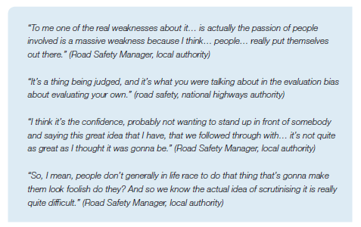
Evaluate then Share, share, share….
Notes:
TF
Just want to finish up with some quotes about evaluation from the recent RACF work, which helps us understand some of the barriers encountered in evaluating and perhaps helps us think about overcoming them
These are some of the barriers

Slide 22
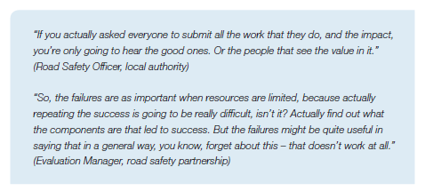
Evaluate then Share, share, share….
Notes:
TF
But it is important to hear about things that don’t work

Slide 23
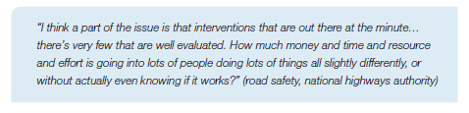
Evaluate then Share, share, share….
Notes:
TF
Real benefits from evaluating and then sharing those results, whatever they might be

Slide 24
Questions…

Slide 25
Tanya fosdick
Amanpreet kaur
+44 1295 731813
+44 7795 385770
tanya.fosdick@agilysis.co.uk
+44 1295 731810
amanpreet.kaur@agilysis.co.uk

